Slide 1
OPERATING SYSTEMS
By
Asst.Prof.J.SNARENDRA KUMAR
Dept of CSE
Aditya College of Engineering & Technology
Surampalem.

Slide 2
Unit-II
Processes
Process Concept
Process Scheduling
Operations on Processes
Interprocess Communication
Examples of IPC Systems
Communication in Client-Server Systems

Slide 3
Objectives
To introduce the notion of a process -- a program in execution, which forms the basis of all computation
To describe the various features of processes, including scheduling, creation and termination, and communication
To describe communication in client-server systems

Slide 4
Process Concept
An operating system executes a variety of programs:
Batch system – jobs
Time-shared systems – user programs or tasks
Textbook uses the terms job and process almost interchangeably
Process – a program in execution; process execution must progress in sequential fashion
A process includes:
program counter
stack
data section

Slide 5
The Process
Multiple parts
The program code, also called text section
Current activity including program counter, processor registers
Stack containing temporary data
Function parameters, return addresses, local variables
Data section containing global variables
Heap containing memory dynamically allocated during run time
Program is passive entity, process is active
Program becomes process when executable file loaded into memory
Execution of program started via GUI mouse clicks, command line entry of its name, etc
One program can be several processes
Consider multiple users executing the same program

Slide 6
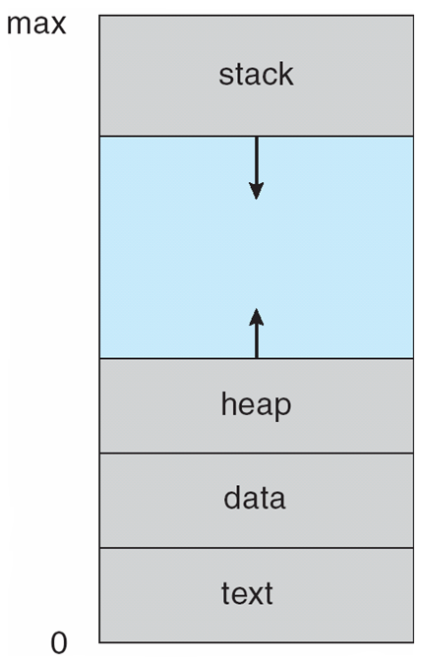
Process in Memory

Slide 7
Process State
As a process executes, it changes state
new: The process is being created
running: Instructions are being executed
waiting: The process is waiting for some event to occur
ready: The process is waiting to be assigned to a processor
terminated: The process has finished execution

Slide 8
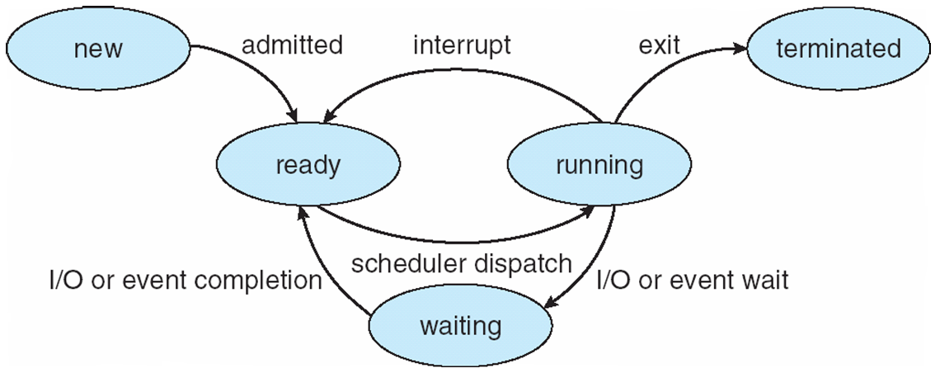
Diagram of Process State

Slide 9
Process Control Block (PCB)
Information associated with each process
Process state
Program counter
CPU registers
CPU scheduling information
Memory-management information
Accounting information
I/O status information

Slide 10
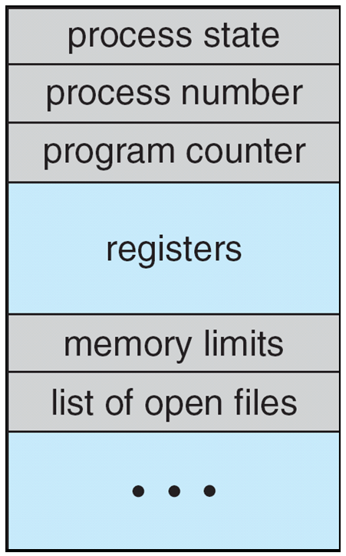
Process Control Block (PCB)

Slide 11
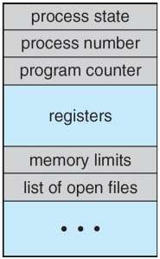

Slide 12
Context Switching
When CPU switches to another process, the system must save the state of the old process and load the saved state for the new process via a context switch
Context of a process represented in the PCB
Context-switch time is overhead; the system does no useful work while switching
Time dependent on hardware support

Slide 13
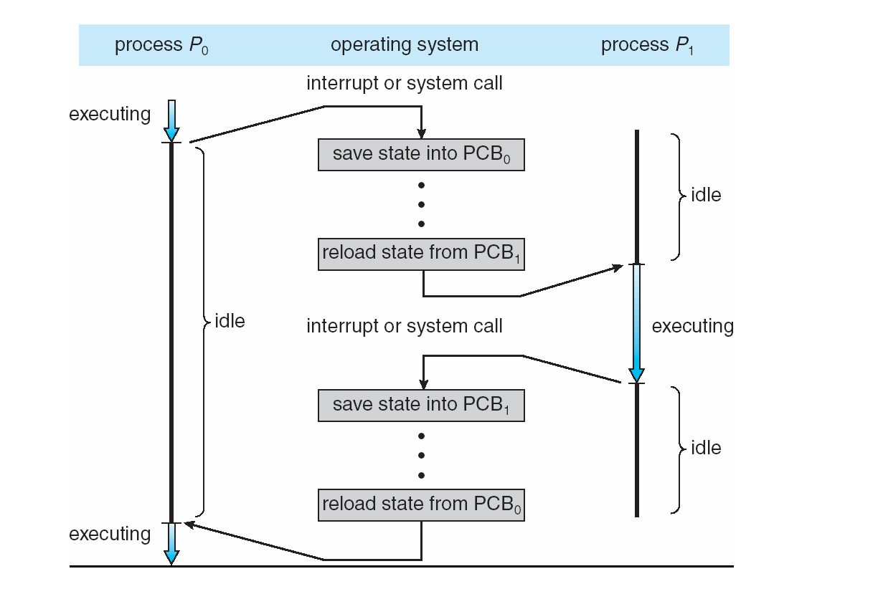
CPU Switch From Process to Process

Slide 14
Process Scheduling
Maximize CPU use, quickly switch processes onto CPU for time sharing
Process scheduler selects among available processes for next execution on CPU
Maintains scheduling queues of processes
Job queue – set of all processes in the system
Ready queue – set of all processes residing in main memory, ready and waiting to execute
Device queues – set of processes waiting for an I/O device
Processes migrate among the various queues

Slide 15
Schedulers
Long-term scheduler (or job scheduler) – selects which processes should be brought into the ready queue
Short-term scheduler (or CPU scheduler) – selects which process should be executed next and allocates CPU
Short-term scheduler is invoked very frequently (milliseconds) ⇒ (must be fast)
Long-term scheduler is invoked very infrequently (seconds, minutes) ⇒ (may be slow)
The long-term scheduler controls the degree of multiprogramming
Processes can be described as either:
I/O-bound process – spends more time doing I/O than computations, many short CPU bursts
CPU-bound process – spends more time doing computations; few very long CPU bursts

Slide 16
Process Creation
Parent process create children processes, which, in turn create other processes, forming a tree of processes
Generally, process identified and managed via a process identifier (pid)
Resource sharing
Parent and children share all resources
Children share subset of parent’s resources
Parent and child share no resources
Execution
Parent and children execute concurrently
Parent waits until children terminate
Address space
Child duplicate of parent
Child has a program loaded into it

Slide 17
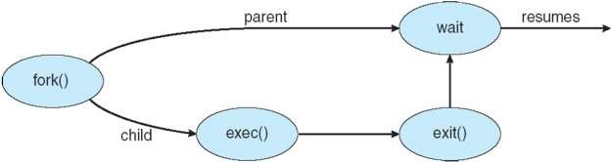
UNIX examples
fork system call creates new process
o exec system call used after a fork to replace the process’ memory space with a new program

Slide 18
Process Termination
Process executes last statement and asks the operating system to delete it (exit)
Output data from child to parent (via wait)
Process’ resources are deallocated by operating system
Parent may terminate execution of children processes (abort)
Child has exceeded allocated resources
Task assigned to child is no longer required
If parent is exiting
Some operating system do not allow child to continue if its parent terminates
All children terminated - cascading termination

Slide 19
Interprocess Communication
Processes within a system may be independent or cooperating
Cooperating process can affect or be affected by other processes, including sharing data
Reasons for cooperating processes:
Information sharing
Computation speedup
Modularity
Convenience
Cooperating processes need interprocess communication (IPC)
Two models of IPC
Shared memory
Message passing

Slide 20
Process & Threads
Process is heavy weight or resource intensive.
Thread is light weight taking lesser resources than a process.
Process switching needs interaction with operating system.
Thread switching does not need to interact with operating system.
In multiple processing environments each process executes the same code but has its own memory and file resources.
All threads can share same set of open files, child processes.
If one process is blocked then no other process can execute until the first process is unblocked.
While one thread is blocked and waiting, second thread in the same task can run.
Multiple processes without using threads use more resources.
Multiple threaded processes use fewer resources.
In multiple processes each process operates independently of the others.
One thread can read, write or change another thread's data.

Slide 21
PROCESS SCHEDULING
An important aspect of multiprogramming is scheduling. The resources that are scheduled are IO and processors.
The goal is to achieve
High processor utilization
High throughput
number of processes completed per unit time
Low response time
time elapse from the submission of a request to the beginning of the response

Slide 22
Types of scheduling
Short-term scheduling
Various scheduling criteria
Various algorithms
Priority queues
First-come, first-served
Round-robin
Shortest process first
Shortest remaining time and others

Slide 23
SCHEDULING CRITERIA
CPU utilization – keep the CPU as busy as possible
Throughput – # of processes that complete their execution per time unit
Turnaround time – amount of time to execute a particular process
Waiting time – amount of time a process has been waiting in the ready queue and blocked queue
Response time – amount of time it takes from when a request was submitted until the first response is produced, not output (for time-sharing environment)

Slide 24
CPU Scheduling Criteria
Max CPU utilization
Max throughput
Min turnaround time
Min waiting time
Min response time

Slide 25
Long-term : To add to the pool of processes to be executed.
Medium-term : To add to the number of processes that are in the main memory.
Short-term : Which of the available processes will be executed by a processor?
IO scheduling: To decide which process’s pending IO request shall be handled by an available IO device.

Slide 26
First-come-first-served (FCFS) scheduling
Processes get the CPU in the order they request it and run until they release it
Ready processes form a FIFO queue

Slide 27
Process Burst Time
P₁ 24
P₂ 3
P₃ 3
Suppose that the processes arrive in the order: P₁ , P₂ , P₃ The Gantt Chart for the schedule is:
Waiting time for P₁ = 0; P₂ = 24; P₃ = 27
Average waiting time: (0 + 24 + 27)/3 = 17
P₁
P₂
P₃
0
24
27
30

Slide 28
Suppose that the processes arrive in the order
P₂ , P₃ , P₁ .
The Gantt chart for the schedule is:
Waiting time for P₁ = 6; P₂ = 0; P₃ = 3
Average waiting time: (6 + 0 + 3)/3 = 3
Much better than previous case.
Convoy effect short process behind long process
P₂
P₃
P₁
0
3
6
30

Slide 29
SHORTEST JOB FIRST(SJF)
Associate with each process the length of its next CPU burst. Use these lengths to schedule the process with the shortest time.
Two schemes:
nonpreemptive – once CPU given to the process it cannot be preempted until completes its CPU burst.
preemptive – if a new process arrives with CPU burst length less than remaining time of current executing process, preempt. This scheme is know as the Shortest-Remaining-Time-First (SRTF).
SJF is optimal – gives minimum average waiting time for a given set of processes.

Slide 30
process AT BT CT MODULE-NON PREEMPTIVE
P1 0 8 8 CRITERIA-BURST TIME
P2 1 4 12
P3 2 9 32
P4 3 5 17
P5 4 6 23
P1 | P2 | P4 | P5

Slide 31
Process AT BT CT TAT WT
P1 0 8-1/7 17 17 9
P2 1 4 5 4 0
P3 2 9 26 24 15
P4 3 5 10 7 2
GHANTT CHART TAT=CT-AT WT=TAT-BT TWT=26/4=6
P1 0 1 | P2 5 | P4 10 | P1 17 | P3 26

Slide 32
Priority Scheduling:
Priority scheduling is a non-preemptive algorithm and one of the most common scheduling algorithms in batch systems.
Each process is assigned a priority. Process with highest priority is to be executed first and so on.
If two jobs having the same priority are READY, it works on a FIRST COME, FIRST SERVED basis.
Priority can be decided based on memory requirements, time requirements or any other resource requirement.

Slide 33
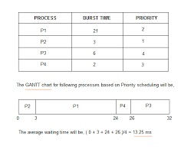

Slide 34
Round Robin Scheduling:
Round Robin is the preemptive process scheduling algorithm.
Each process is provided a fix time to execute, it is called a quantum.
Once a process is executed for a given time period, it is preempted and other process executes for a given time period.
This is the preemptive version of first come first serve scheduling
Every process gets executed in a cyclic way

Slide 35
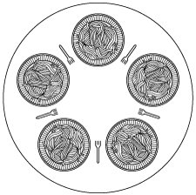
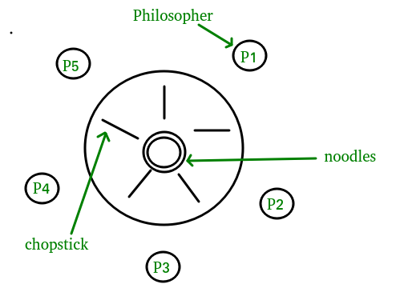
DINING PHILOSHOPERS PROBLEM
deadlock

Slide 36
1.Left
2.Right
3.Eating
4.Thinking
5.Waiting

Slide 37
WAITING FOR BOTHCHOP STICKS FROM LEFT AND RIGHT
PUT THE LEFT STICK DOWN ..KEEP WAITING FOR THE RIGHT STICK—I
BLOCKING TWO PHILOSHOPERS AND KEEP CONTINUE WITH THE REMAINING RESOURCES---II
SEMAPHORES
MUTEXES

Slide 38
#define N 5
#define LEFT
#define RIGHT
#define THINKING 0
#define HUNGRY 1
#define EATING 2
Typedef int semaphore;
Int state[N];
Mutex=1;

Slide 39
While(TRUE) /*REPEAT FOREVER*/
{
Think();
Take forks();/*block or either acquire the resources*/ P1=HUNGRY-------> ALLOCATED
Eat();
Put forks();
}
Down(mutex) /*by entering into the criticalstage*/
State=THINKING/*FINISHED EATING*/ P1=FINISHED EATING-------------→ LEFT CHOPSTICK RIGHT CS
Test(left);
Test(right);
Up(mutex);

Slide 40
Readers and writers problems:

Slide 41
SLEEPING BARBERS PROBLEM
Do
{
Wait(customers) /*4 customers*/
Wait(mutex)
customer count--;/*3 customer*/
Signal(barber);
Signal(mutex)
cut_hair();
}

Slide 42
QUERIES?

Slide 43
3 MEMORY MANAGEMENT
Memory management is concerned with managing the primary memory. Memory consists of array of bytes or words each with their own address. The instructions are fetched from the memory by the CPU based on the value program counter.

Slide 44
Functions of memory management:
Keeping track of status of each memory location.
Determining the allocation policy.
Memory allocation technique.
De-allocation technique.

Slide 45
The ideal world has memory that is
Very large
Very fast
Non-volatile (doesn’t go away when power is turned off)
The real world has memory that is:
Very large
Very fast
Affordable!
Pick any two…
Memory management goal: make the real world look as much like the ideal world as possible

Slide 46
What is the memory hierarchy?
Different levels of memory
Some are small & fast
Others are large & slow
What levels are usually included?
Cache: small amount of fast, expensive memory
L1 (level 1) cache: usually on the CPU chip
L2 & L3 cache: off-chip, made of SRAM
Main memory: medium-speed, medium price memory (DRAM)
Disk: many gigabytes of slow, cheap, non-volatile storage
Memory manager handles the memory hierarchy

Slide 47
Basic memory management
Components include
Operating system (perhaps with device drivers)
Single process
Goal: lay these out in memory
Memory protection may not be an issue (only one program)
Flexibility may still be useful (allow OS changes, etc.)
No swapping or paging

Slide 48
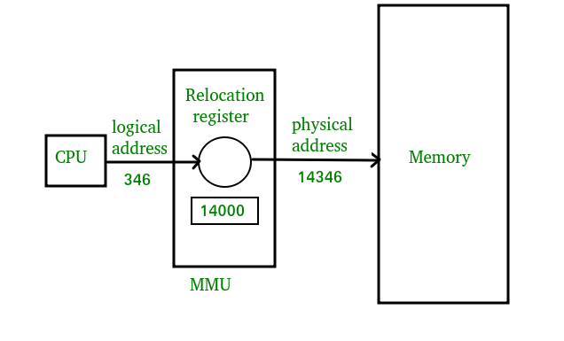

Slide 49
Swapping:
Swapping is a technique of temporarily removing inactive programs from the memory of the system
A process can be swapped temporarily out of the memory to a backing store and then brought back in to the memory for continuing the execution
This process is called swapping.

Slide 50
Eg:-In a multi-programming environment with a round robin CPU scheduling whenever the time quantum expires then the process that has just finished is swapped out and a new process swaps in to the memory for execution.
A variation of swap is priority based scheduling. When a low priority is executing and if a high priority process arrives then a low priority will be swapped out and high priority is allowed for execution. This process is also called as Roll out and Roll in.
Normally the process which is swapped out will be swapped back to the same memory space that is occupied previously

Slide 51
Swapping requires backing store and it should be large enough to accommodate the copies of all memory images
To swap a process, it should be completely idle. A process may be waiting for an i/o operation. If the i/o is asynchronously accessing the user memory for i/o buffers, then the process cannot be swapped.

Slide 52
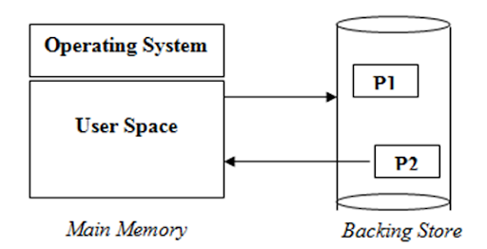

Slide 53
Contiguous Allocation
If the blocks are allocated to the file in such a way that all the logical blocks of the file get the contiguous physical block in the hard disk then such allocation scheme is known as contiguous allocation

Slide 54
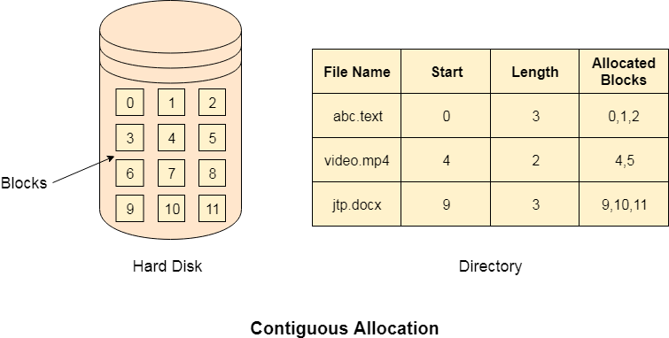

Slide 55
If the blocks are allocated to the file in such a way that all the logical blocks of the file get the contiguous physical block in the hard disk then such allocation scheme is known as contiguous allocation
The usual way to implement contiguous memory allocation is to divide the memory into several fixed-sized portions. Each portion can be allocated to one process. The computer’s capability to run multiple programs thus depends on the number of partitions. Only when one section is free can another process from the input queue be loaded for execution.

Slide 56
Strategies Used for Contiguous Memory Allocation Input Queues
First-fit strategy: The system allocates the first available memory block big enough for the process. Searching can start either from the first block or where the previous first-fit search ended. It stops looking as soon as it finds a free block that fits the process.
Best-fit strategy: The system allocates the smallest memory block available that fits the process. It searches the entire list of blocks unless they are arranged according to size. The strategy leaves the smallest block unused

Slide 57
Worst-fit strategy: The system allocates the largest available memory block. It must search the entire list unless the blocks are sorted by size. The procedure leaves the largest memory block unused.

Slide 58
Paging:
Paging is a storage mechanism used to retrieve processes from the secondary storage into the main memory in the form of pages
Paging will divide each process in the form of pages
The main memory will also be divided in the form of frames
One page of the process is to be stored in one of the frames of the memory

Slide 59
The pages can be stored at the different locations of the memory but the priority is always to find the contiguous frames
Pages of the process are brought into the main memory only when they are required otherwise they reside in the secondary storage
Different operating system defines different frame sizes
The sizes of each frame must be equal

Slide 60
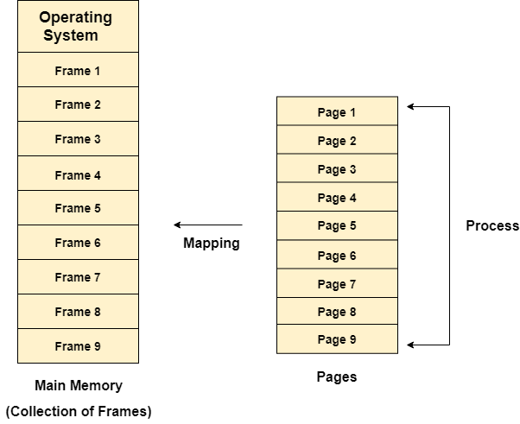

Slide 61
Let us consider the main memory size 16 Kb and Frame size is 1 KB therefore the main memory will be divided into the collection of 16 frames of 1 KB each.
There are 4 processes in the system that is P1, P2, P3 and P4 of 4 KB each. Each process is divided into pages of 1 KB each so that one page can be stored in one frame

Slide 62
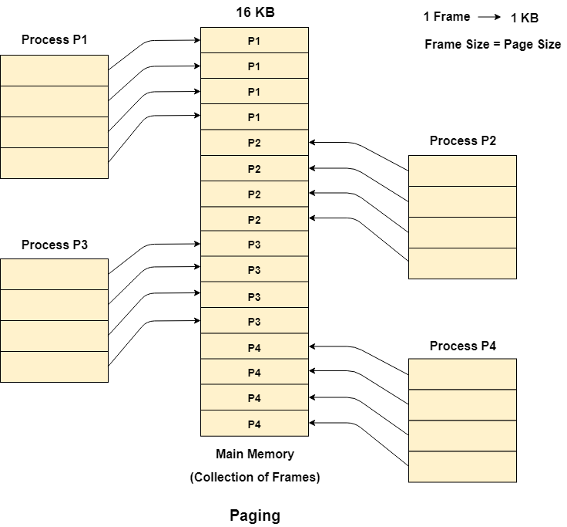

Slide 63
Segmentation
Segmentation is a memory management technique in which, the memory is divided into the variable size parts. Each part is known as segment which can be allocated to a process
The details about each segment are stored in a table called as segment table.
Segment table is stored in one (or many) of the segments

Slide 64
Segment table contains mainly two information about segment:
Base: It is the base address of the segment
Limit: It is the length of the segment.

Slide 65
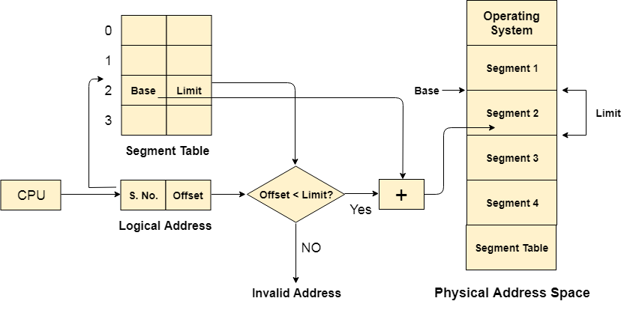

Slide 66
The Segment number is mapped to the segment table. The limit of the respective segment is compared with the offset. If the offset is less than the limit then the address is valid otherwise it throws an error as the address is invalid.
In the case of valid address, the base address of the segment is added to the offset to get the physical address of actual word in the main memory.

Slide 67
Virtual Memory:
computer can address more memory than the amount physically installed on the system
This extra memory is actually called virtual memory
it is a section of a hard disk that's set up to emulate the computer's RAM.
programs can be larger than physical memory.

Slide 68
Virtual memory serves two purposes.
First, it allows us to extend the use of physical memory by using disk.
Second, it allows us to have memory protection, because each virtual address is translated to a physical address

Slide 69
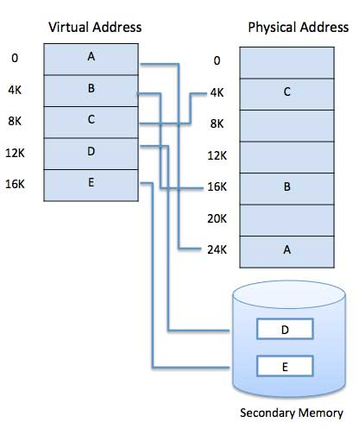

Slide 70
Copy-on-Write
The idea behind a copy-on-write fork is that the pages for a parent process do not have to be actually copied for the child until one or the other of the processes changes the page.
They can be simply shared between the two processes in the meantime, with a bit set that the page needs to be copied if it ever gets written to
Copy-on-Write(CoW) is mainly a resource management technique that allows the parent and child process to share the same pages of the memory initially.

Slide 71
If any process either parent or child modifies the shared page, only then the page is copied.
The main intention behind the CoW technique is that whenever a parent process creates a child process both parent and child process initially will share the same pages in the memory
These shared pages between parent and child process will be marked as copy-on-write which means that if the parent or child process will attempt to modify the shared pages then a copy of these pages will be created and the modifications will be done

Slide 72
only on the copy of pages by that process and it will not affect other processes.

Slide 73
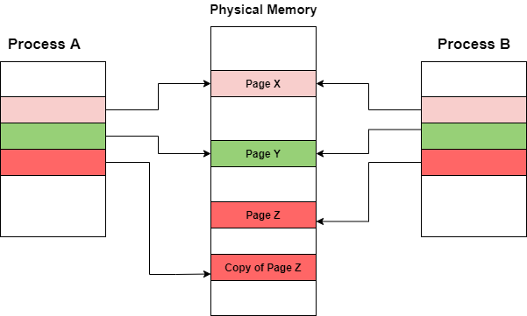

Slide 74
Paging
An OS makes use of a process called paging for virtual memory management (VMM).
Paging is a process of reading data from, and writing data to, the secondary storage
Whenever a process refers to a page that is not present in memory, a page fault occurs
Subsequently, the OS replaces one of the existing pages with the referred page

Slide 75
Page replacement algorithms are an important part of virtual memory management and it helps the OS to decide which memory page can be moved out, making space for the currently needed page.
The ultimate objective of all page replacement algorithms is to reduce the number of page faults.
A page fault is a computer hardware raised interrupt or an exception when a running program accesses a memory page that is not currently mapped into the virtual address space of the program.

Slide 76
First-In-First-Out (FIFO)
With the FIFO algorithm, the OS maintains a queue to keep track of all the pages in memory, with the most recent arrival at the back (tail of the queue), and the oldest arrival in front (head of the queue).
When the system needs space, a page will be replaced

Slide 77
Thrashing
Thrashing occurs when a Process is spending more time in paging or Swapping activities rather than its execution.
In Thrashing, the state CPU is so much busy swapping that it cannot respond to the user program as much as it required.

Slide 78
Causes of Thrashing
Thrashing affects the performance of execution
Initially, when the CPU utilization is low, then the process scheduling mechanism loads many processes into the Memory simultaneously so that the Degree of Multiprogramming can be increased
When any higher priority Process arrives in MemoryMemory and if the frame is not freely available at that time, then the other process that occupied the frame which resides in the frame will move to secondary storage, and this free frame is now allocated to a higher priority process.

Slide 79
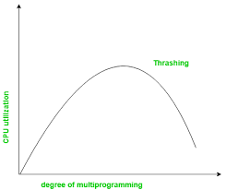

Slide 80
Allocating Kernel Memory
When a process running in user mode requests additional memory, pages are allocated from the list of free page frames maintained by the kernel(page replacement algorithm)
if a user process requests a single byte of memory, internal fragmentation will result, as the process will be granted, an entire page frame.
Kernel memory, however, is often allocated from a free-memory pool different from the list used to satisfy ordinary user-mode processes. There are two primary reasons for this

Slide 81
The kernel requests memory for data structures of varying sizes, some of which are less than a page in size. As a result, the kernel must use memory conservatively and attempt to minimize waste due to fragmentation.
Pages allocated to user-mode processes do not necessarily have to be in contiguous physical memory. However, certain hardware devices interact directly with physical memory—-without the benefit of a virtual memory interface—and consequently may require memory residing in physically contiguous pages.

Slide 82
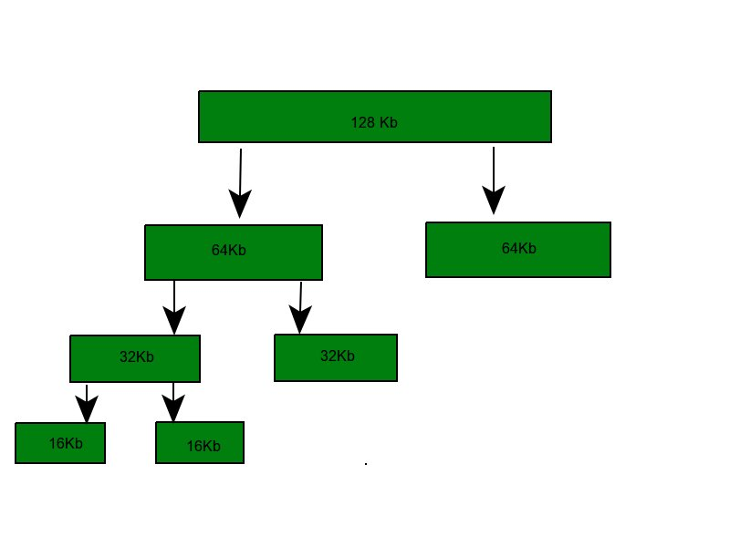
Buddy System:

Slide 83
Why buddy system? If the partition size and procees size are different then poor match occurs and may use space inefficiently. It is easy to implement and efficient then dynamic allocation
Binary buddy system – The buddy system maintains a list of the free blocks of each size (called a free list), so that it is easy to find ablock of the desired size, if one is available. If no block of the requested size is available, Allocate searches for the first nonempty list for blocks of atleast the size requested. In either case, a block is removed from the free list.

Slide 84
Example – Assume the size of memory segment is initially 256kb and the kernel rquests 25kb of memory. The segment is initially divided into two buddies. Let we call A1 and A2 each 128kb in size. One of these buddies is further divided into two 64kb buddies let say B1 and B2. But the next highest power of 25kb is 32kb so, either B1 or B2 is further divided into two 32kb buddies(C1 and C2) and finally one of these buddies is used to satisfy the 25kb request. A split block can only be merged with its unique buddy block, which then reforms the larger block they were split from.

Slide 85
Slab Allocation
A second strategy for allocating kernel memory is known as slab allocation
It eliminates fragmentation caused by allocations and deallocations. This method is used to retain allocated memory that contains a data object of a certain type for reuse upon subsequent allocations of objects of the same type
In slab allocation memory chunks suitable to fit data objects of certain type or size are preallocated

Slide 86
Cache does not free the space immediately after use although it keeps track of data which are required frequently so that whenever request is made the data will reach very fast
Two terms required are
Slab – A slab is made up of one or more physically contiguous pages. The slab is the actual container of data associated with objects of the specific kind of the containing cache.
Cache – Cache represents a small amount of very fast memory. A cache consists of one or more slabs. There is a single cache for each unique kernel data structure.

Slide 87
A separate cache for a data structure representing processes descriptors
Separate cache for file objects
Separate cache for semaphores etc.

Slide 88
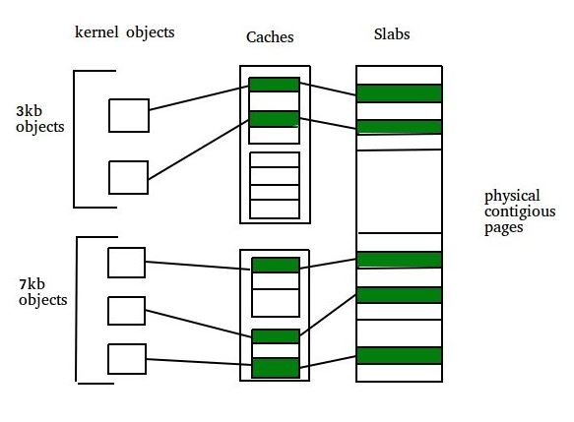

Slide 89
Deadlock in Operating System
A process in operating systems uses different resources and uses resources in the following way. 1) Requests a resource 2) Use the resource 3) Releases the resource

Slide 90
Deadlock is a situation where a set of processes are blocked because each process is holding a resource and waiting for another resource acquired by some other process. Consider an example when two trains are coming toward each other on the same track and there is only one track, none of the trains can move once they are in front of each other. A similar situation occurs in operating systems when there are two or more processes that hold some resources and wait for resources held by other(s). For example, in the below diagram, Process 1 is holding Resource 1 and waiting for resource 2 which is acquired by process 2, and process 2 is waiting for resource 1.

Slide 91
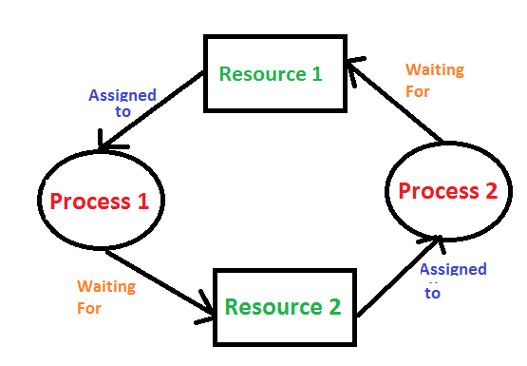

Slide 92
System Model
For the purposes of deadlock discussion, a system can be modeled as a collection of limited resources, which can be partitioned into different categories, to be allocated to a number of processes, each having different needs.
Resource categories may include memory, printers, CPUs, open files, tape drives, CD-ROMS, etc.

Slide 93
By definition, all the resources within a category are equivalent, and a request of this category can be equally satisfied by any one of the resources in that category. If this is not the case ( i.e. if there is some difference between the resources within a category ), then that category needs to be further divided into separate categories. For example, "printers" may need to be separated into "laser printers" and "color inkjet printers

Slide 94
In normal operation a process must request a resource before using it, and release it when it is done, in the following sequence: 1. Request - If the request cannot be immediately granted, then the process must wait until the resource(s) it needs become available. Example: system calls open( ), malloc( ), new( ), and request( ). 2. Use - The process uses the resource.
Example: prints to the printer or reads from the file.
3. Release - The process relinquishes the resource. so that it becomes available for other processes.
Example: close( ), free( ), delete( ), and release( ).
For all kernel-managed resources, the kernel keeps track of what resources are free and which are allocated, to which process they are allocated, and a queue of processes waiting for this resource to become available. Application-managed resources can be controlled using mutexes or wait( ) and signal( ) calls, ( i.e. binary or counting semaphores. ) ● A set of processes is deadlocked when every process in the set is waiting for a resource that is currently allocated to another process in the set ( and which can only be released when that other waiting process makes progress. )

Slide 95
Conditions for Deadlock
Deadlock is a situation which involves the interaction of more than one resources and processes with each other

Slide 96
Mutual Exclusion: When two people meet in the landings, they can’t just walk through because there is space only for one person. This condition to allow only one person (or process) to use the step between them (or the resource) is the first condition necessary for the occurrence of the deadlock.
Hold and Wait: When the 2 people refuses to retreat and hold their grounds, it is called holding. This is the next necessary condition for the the deadlock.
No Preemption: For resolving the deadlock one can simply cancel one of the processes for other to continue. But Operating System doesn’t do so. It allocates the resources to the processors for as much time needed until the task is completed. Hence, there is no temporary reallocation of the resources. It is third condition for deadlock.
Circular Wait: When the two people refuses to retreat and wait for each other to retreat, so that they can complete their task, it is called circular wait. It is the last condition for the deadlock to occur.

Slide 97
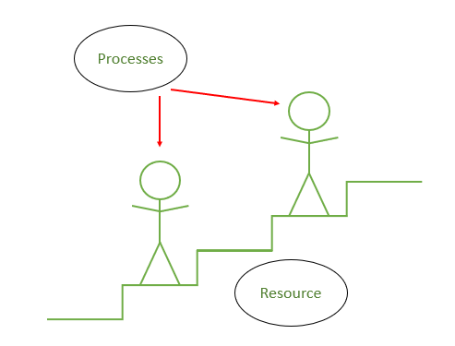
Example problem for describing a Deadlock

Slide 98
Resource Allocation Graph
In some cases deadlocks can be understood more clearly through the use of Resource-Allocation Graphs, having the following properties:
A set of resource categories, { R1, R2, R3, . . ., RN }, which appear as square nodes on the graph. Dots inside the resource nodes indicate specific instances of the resource. ( E.g. two dots might represent two laser printers. ) *A set of processes, { P1, P2, P3, . . ., PN }

Slide 99
*Request Edges - A set of directed arcs from Pi to Rj, indicating that process Pi has requested Rj, and is currently waiting for that resource to become available. *Assignment Edges - A set of directed arcs from Rj to Pi indicating that resource Rj has been allocated to process Pi, and that Pi is currently holding resource Rj. Note that a request edge can be converted into an assignment edge by reversing the direction of the arc when the request is granted. ( However note also that request edges point to the category box, whereas assignment edges emanate from a particular instance dot within the box. )

Slide 100
In Resource allocation graph, the process is represented by a Circle while the Resource is represented by a rectangle. Let's see the types of vertices and edges in detail.

Slide 101
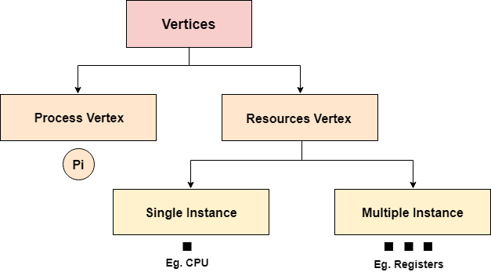

Slide 102
Vertices are mainly of two types, Resource and process. Each of them will be represented by a different shape. Circle represents process while rectangle represents resource.
A resource can have more than one instance. Each instance will be represented by a dot inside the rectangle.

Slide 103
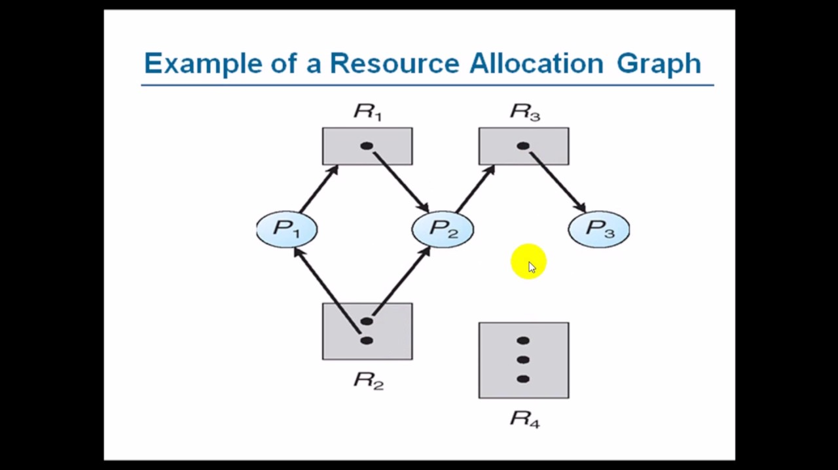

Slide 104
A file is a collection of correlated information which is recorded on secondary or non-volatile storage like magnetic disks, optical disks, and tapes. It is a method of data collection that is used as a medium for giving input and receiving output from that program.

Slide 105
In general, a file is a sequence of bits, bytes, or records whose meaning is defined by the file creator and user. Every File has a logical location where they are located for storage and retrieval.

Slide 106
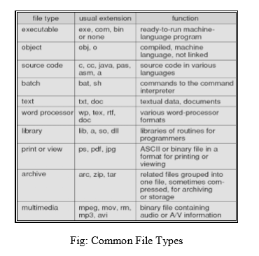

Slide 107
File Structure :
Some files contain an internal structure, which may or may not be known to the OS.
For the OS to support particular file formats increases the size and complexity of the OS.
UNIX treats all files as sequences of bytes, with no further consideration of the internal structure. ( With the exception of executable binary programs, which it must know how to load and find the first executable statement, etc. )

Slide 108
Macintosh files have two forks - a resource fork, and a data fork. The resource fork contains information relating to the UI, such as icons and button images, and can be modified independently of the data fork, which contains the code or data as appropriate.
Directory Structure
Storage Structure
A disk can be used in its entirety for a file system. Alternatively a physical disk can be broken up into multiple partitions, slices, or minidisks, each of which becomes a virtual disk and can have its own file system. ( or be used for raw storage, swap space, etc. ) Or, multiple physical disks can be combined into one volume, i.e. a larger virtual disk, with its own file system spanning the physical disks.

Slide 109
Directory Overview
Directory operations to be supported include: o Search for a file o Create a file - add to the directory o Delete a file - erase from the directory o List a directory - possibly ordered in different ways. o Rename a file - may change sorting order

Slide 110
File System Management and Optimization
Disk-Space Management
Since all the files are normally stored on disk one of the main concerns of file system is management of disk space.
Block Size
The main question that arises while storing files in a fixed-size blocks is the size of the block. If the block is too large space gets wasted and if the block is too small time gets waste. So, to choose a correct block size some information about the file-size distribution is required. Performance and space-utilization are always in conflict.

Slide 111
Keeping track of free blocks
After a block size has been finalized the next issue that needs to be catered is how to keep track of the free blocks. In order to keep track there are two methods that are widely used:
Using a linked list: Using a linked list of disk blocks with each block holding as many free disk block numbers as will fit.

Slide 112
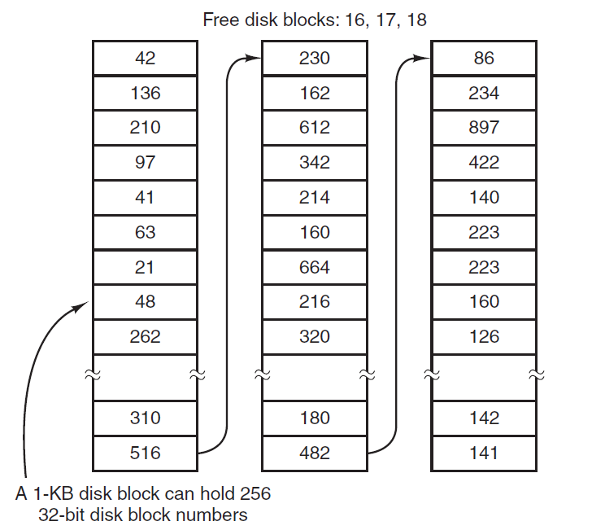

Slide 113
Bitmap: A disk with n blocks has a bitmap with n bits. Free blocks are represented using 1's and allocated blocks as 0's as seen below in the figure.
Disk quotas
Multiuser operating systems often provide a mechanism for enforcing disk quotas. A system administrator assigns each user a maximum allotment of files and blocks and the operating system makes sure that the users do not exceed their quotas. Quotas are kept track of on a per-user basis in a quota table.

Slide 114
File-system Backups
If a computer's file system is irrevocably lost, whether due to hardware or software restoring all the information will be difficult, time consuming and in many cases impossible. So it is adviced to always have file-system backups. Backing up files is time consuming and as well occupies large amount of space, so doing it efficiently and convenietly is important

Slide 115
Is it requied to backup the entire file system or only a part of it.
Backing up files that haven't been changed from previous backup leads to incremental dumps. So it's better to take a backup of only those files which have changed from the time of previous backup. But recovery gets complicated in such cases.
Since there is immense amount of data, it is generally desired to compress the data before taking a backup for the same.
It is difficult to perform a backup on an active file-system since the backup may be inconsistent.
Making backups introduces many security issues

Slide 116
Secondary storage devices are those devices whose memory is non volatile, meaning, the stored data will be intact even if the system is turned off. Here are a few things worth noting about secondary storage.

Slide 117
Secondary storage is also called auxiliary storage.
Secondary storage is less expensive when compared to primary memory like RAMs.
The speed of the secondary storage is also lesser than that of primary storage.
Hence, the data which is less frequently accessed is kept in the secondary storage.
A few examples are magnetic disks, magnetic tapes, removable thumb drives etc.

Slide 118
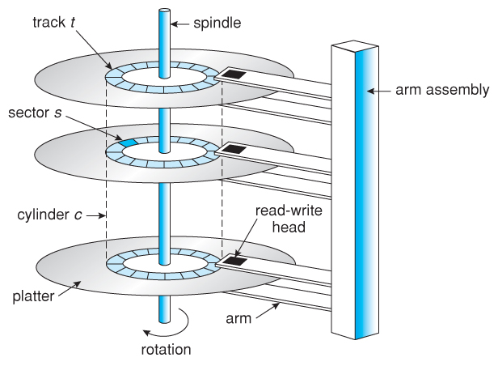

Slide 119
Disk Scheduling Algorithms
In multiprogramming systems, there will usually be multiple disk access requests at any point of time. So those requests must be scheduled to achieve good efficiency. Disk scheduling is similar to process scheduling

Slide 120
First Come First Serve
This algorithm performs requests in the same order asked by the system. Let's take an example where the queue has the following requests with cylinder numbers as follows:
98, 183, 37, 122, 14, 124, 65, 67
Assume the head is initially at cylinder 56. The head moves in the given order in the queue i.e., 56→98→183→...→67.

Slide 121
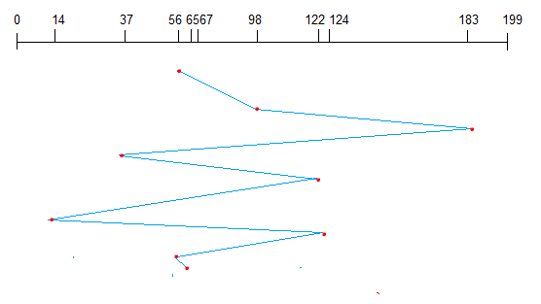

Slide 122
Shortest Seek Time First (SSTF)
Here the position which is closest to the current head position is chosen first. Consider the previous example where disk queue looks like,
98, 183, 37, 122, 14, 124, 65, 67
Assume the head is initially at cylinder 56. The next closest cylinder to 56 is 65, and then the next nearest one is 67, then 37, 14, so on.

Slide 123
RAID Structure(Redundant Arrays of Independent Disks)
Disk drives have continued to get smaller and cheaper, so it is now economically feasible to attach many disks to a computer system.
Having a large number of disks in a system presents opportunities for improving the rate at which data can be read or written, if the disks are operated in parallel.
Furthermore, this setup offers the potential for improving the reliability of data storage, because redundant information can be stored on multiple disks. Thus, failure of one disk does not lead to loss of data.

Slide 124
A variety of disk-organization techniques, collectively called redundant array of independent disks (RAIDs), are commonly used for performance and reliability issues
RAID Structure
RAID – multiple disk drives provides reliability via redundancy
All RAID have the property that the data are distributed over drives, to allow parallel operation.
RAID is arranged into six different levels

Slide 125
Several improvements in disk-use techniques involve the use of multiple disks working cooperatively
Disk striping uses a group of disks as one storage unit
RAID schemes improve performance and improve the reliability of the storage system by storing redundant data
Mirroring or shadowing (RAID 1) keeps duplicate of each disk – Striped mirrors (RAID 1+0) or mirrored stripes (RAID 0+1) provides high performance and high reliability – Block interleaved parity (RAID 4, 5, 6) uses much less redundancy

Slide 126
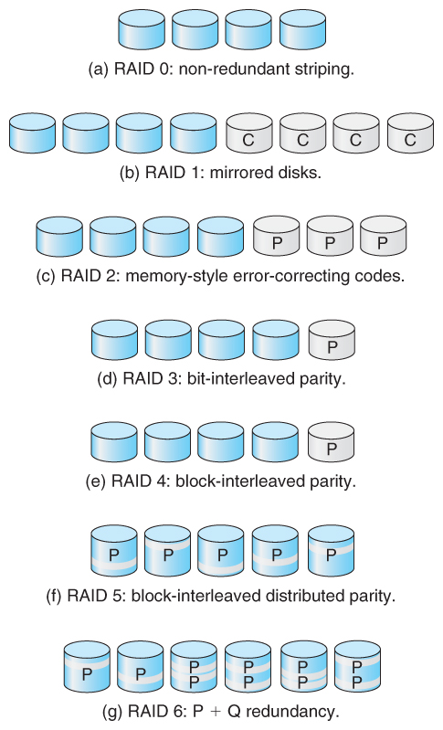

Slide 127
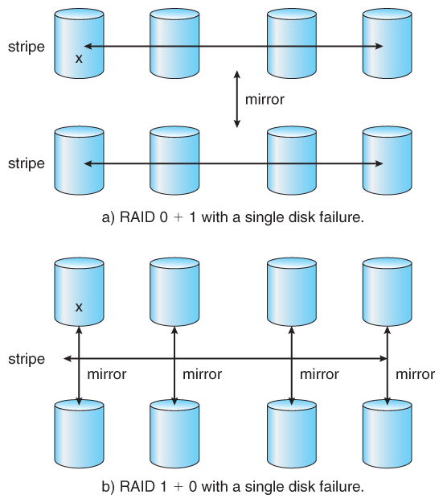

Slide 128

Image of a five-tray RAID hard drive

Slide 129
Stable-Storage Implementation
information residing in the Stable-Storage is never lost. Even, if the disk and CPU have some errors, it will never lose any data.
To achieve such storage, we need to replicate the required information on multiple storage devices with independent failure modes. The writing of an update should be coordinate in such a way that it would not delete all the copies of the state and that, when we are recovering from a failure, we can force all the copies to a consistent and correct value, even if another failure occurs during the recovery. In these, we discuss how to meet these needs.

Slide 130
Tertiary Storage Devices
Low cost is the defining characteristic of tertiary storage
Generally, tertiary storage is built using removable media
Common examples of removable media are floppy disks and CD-ROMs; other types are available

Slide 131
Removable Disks
Floppy disk — thin flexible disk coated with magnetic material, enclosed in a protective plastic case
Most floppies hold about 1 MB; similar technology is used for removable disks that hold more than 1 GB
Removable magnetic disks can be nearly as fast as hard disks, but they are at a greater risk of damage from exposure
A magneto-optic disk records data on a rigid platter coated with magnetic material
Laser heat is used to amplify a large, weak magnetic field to record a bit
Laser light is also used to read data (Kerr effect)

Slide 132
The magneto-optic head flies much farther from the disk surface than a magnetic disk head, and the magnetic material is covered with a protective layer of plastic or glass; resistant to head crashes
Optical disks do not use magnetism; they employ special materials that are altered by laser light

Slide 133
WORM Disks
The data on read-write disks can be modified over and over
WORM (“Write Once, Read Many Times”) disks can be written only once
Thin aluminum film sandwiched between two glass or plastic platters
To write a bit, the drive uses a laser light to burn a small hole through the aluminum; information can be destroyed by not altered
Very durable and reliable
Read-only disks, such ad CD-ROM and DVD, com from the factory with the data pre-recorded

Slide 134
System Protection
Protection refers to a mechanism which controls the access of programs, processes, or users to the resources defined by a computer system. We can take protection as a helper to multi programming operating system, so that many users might safely share a common logical name space such as directory or files

Slide 135
Goals of Protection
Principles of Protection
Domain of Protection
Access Matrix
Implementation of Access Matrix
Access Control

Slide 136
Goals of Protection
In one protection model, computer consists of a collection of objects, hardware or software
Each object has a unique name and can be accessed through a well-defined set of operations
Protection problem - ensure that each object is accessed correctly and only by those processes that are allowed to do so

Slide 137
In one protection model, computer consists of a collection of objects, hardware or software
Each object has a unique name and can be accessed through a well-defined set of operations
Protection problem - ensure that each object is accessed correctly and only by those processes that are allowed to do so

Slide 138
Principles of Protection
Guiding principle – principle of least privilege
Programs, users and systems should be given just enough privileges to perform their tasks
Limits damage if entity has a bug, gets abused
Can be static (during life of system, during life of process)
Or dynamic (changed by process as needed) – domain switching, privilege escalation
“Need to know” a similar concept regarding access to data

Slide 139
UNIX & OPERATING SYSTEM LAB

